Slide 1
Amplification Plot
5.0
4.5
4.0
3.5
3.0
2.5
2.0
1.5
1.0
0.5
0.0
2
4
6
8
10
12
14
16
18
20
22
24
26
28
30
32
34
36
38
40
42
Cycle
BEAS-2B
H1299
GD

Slide 2
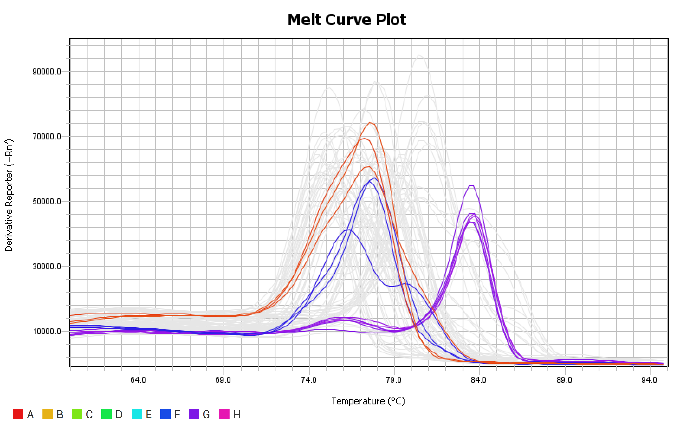

Slide 3
Amplification Plot
2.50
2.25
2.00
1.75
1.50
1.25
1.00
0.75
0.50
0.25
0.00
2
4
6
8
10
12
14
16
18
20
22
24
26
28
30
32
34
36
38
40
Cycle
A549
BEAS-2B
GD

Slide 4
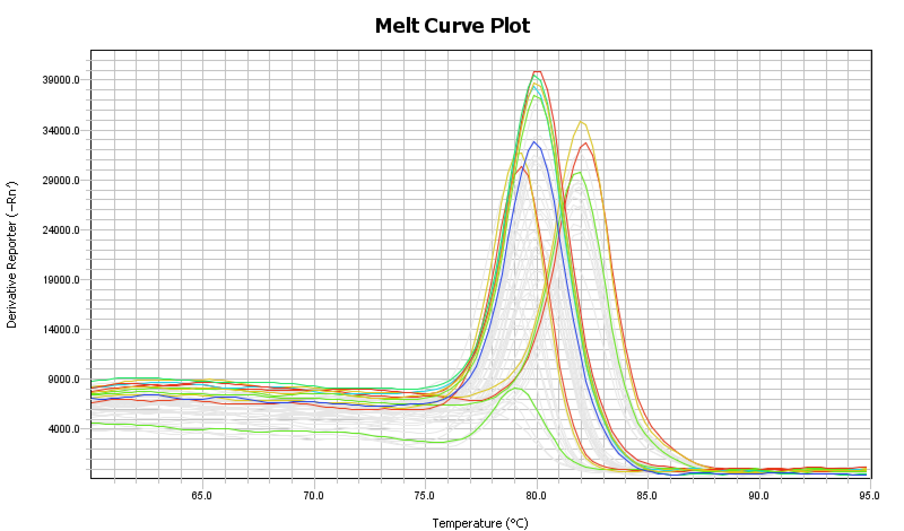

Slide 5
Amplification Plot
5.0
4.5
4.0
3.5
3.0
2.5
2.0
1.5
1.0
0.5
0.0
2
4
6
8
10
12
14
16
18
20
22
24
26
28
30
32
34
36
38
40
42
Cycle
H1299
BEAS-2B
GD

Slide 6
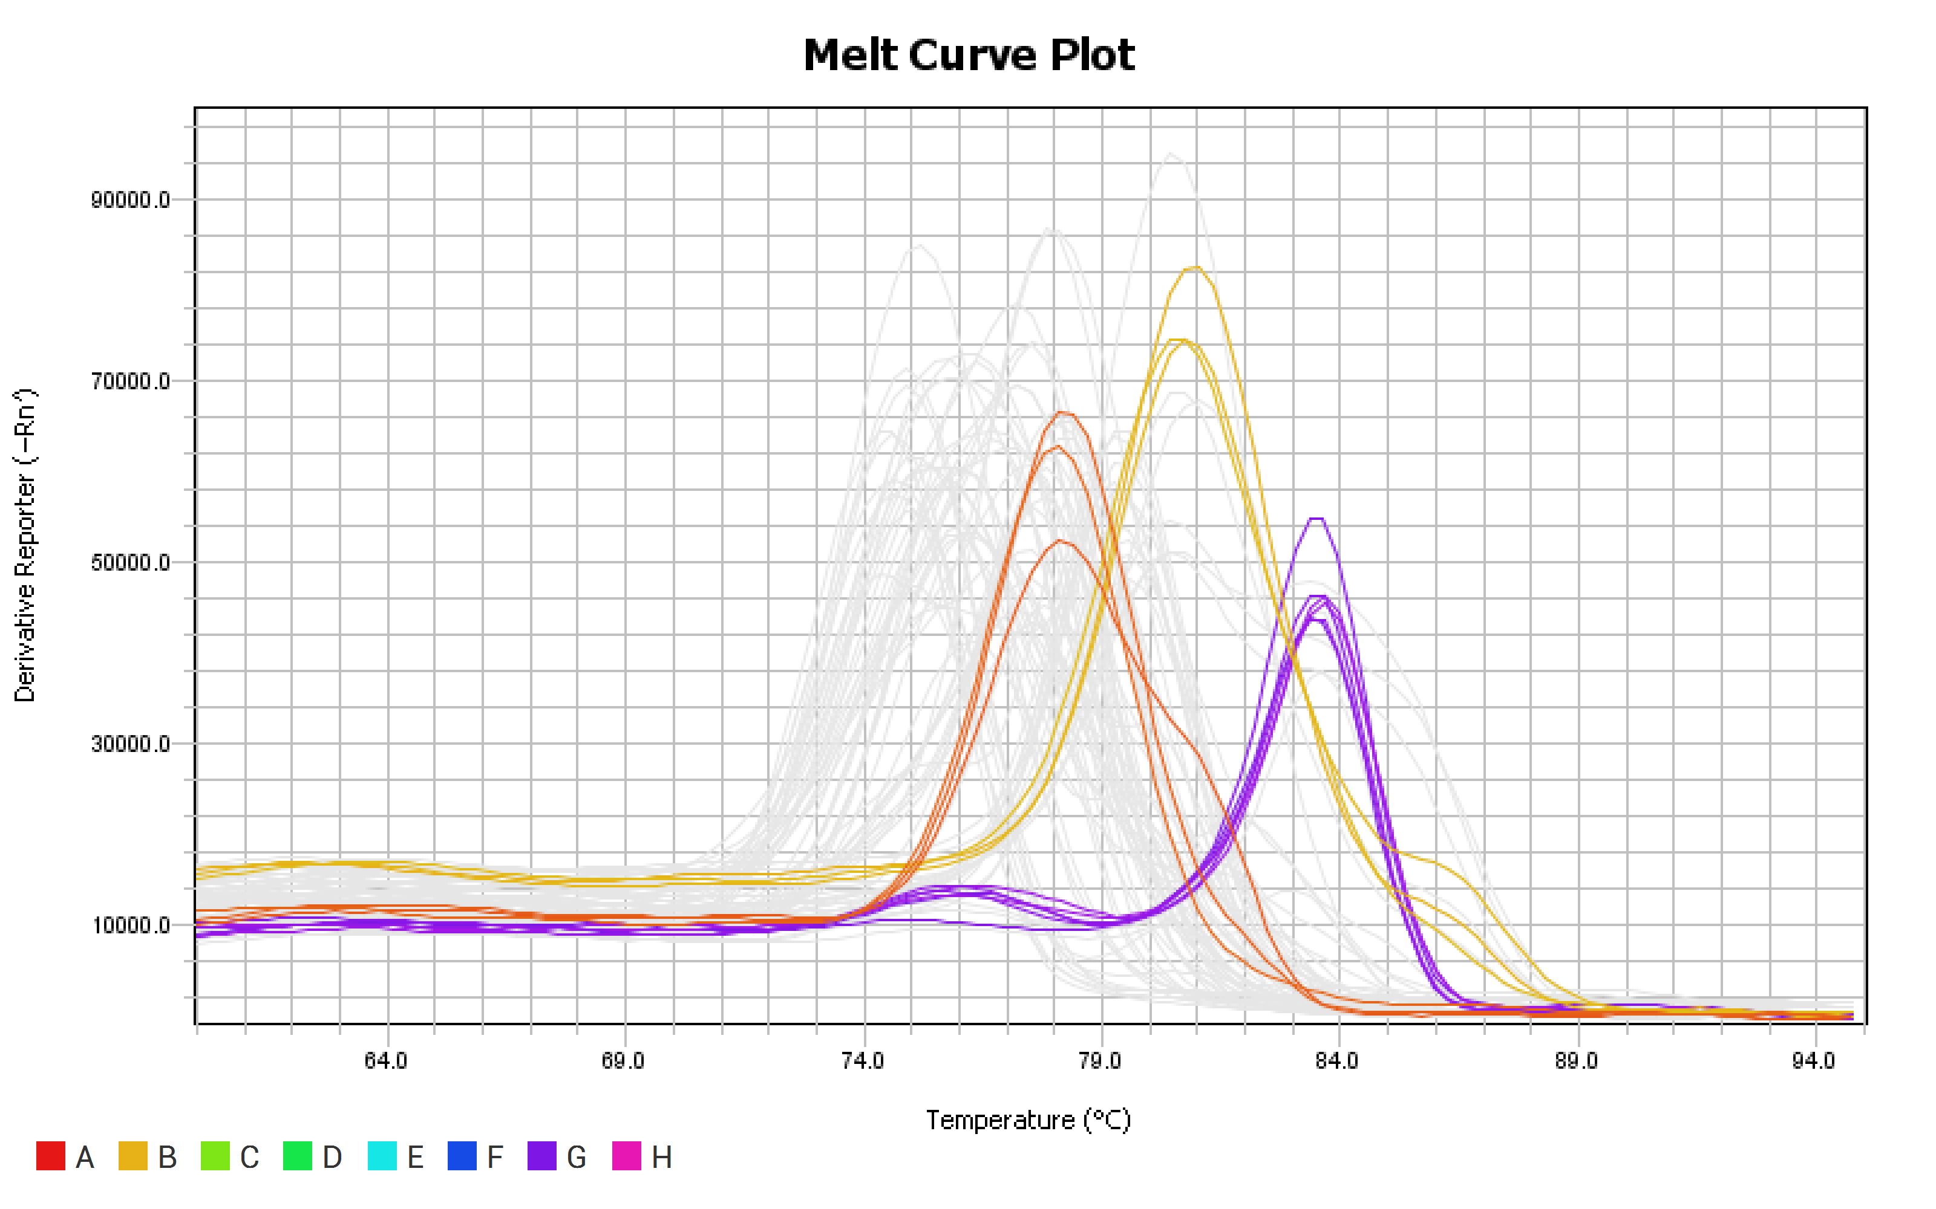

Slide 7
Amplification Plot
2.50
2.25
2.00
1.75
1.50
1.25
1.00
0.75
0.50
0.25
0.00
2
4
6
8
10
12
14
16
18
20
22
24
26
28
30
32
34
36
38
40
Cycle
BEAS-2B
A549
GD

Slide 8
